Slide 1
Introduction to Project Management
Lecture 1
Information Technology Project Management, Fifth Edition, Copyright 2007

Slide 2
Introduction
Many organizations today have a new or renewed interest in project management
New technologies such as computer hardware, software, networks, and the use of interdisciplinary and global work teams have radically changed the work environment
The U.S. spends $6.3 trillion on projects every year, which is 25.1% of its gross domestic product, and the world as a whole spends nearly $100.83 trillion of its gross product on projects of all kinds in 2022
The global Information Technology market was valued at US$ 341.64 billion in 2022 and will grow at a compounded annual growth rate (CAGR) of 11.26% to reach a value of US$ 582.33 billion by 2027

Slide 3
Introduction
Today’s companies, governments, and nonprofit organizations are recognizing that to be successful, they need to use modern project management techniques, especially for IT projects.
Individuals are realizing that to remain competitive in the workplace, they must develop skills to become good project team members and project managers.
They also realize that many of the concepts of project management will help them in their everyday lives as they work with people and technology on a day-to-day basis.

Slide 4
Top Ten Technology Projects in 2025
Generative AI
Quantum Computing
5G Expansion
Virtual Reality (VR)
Augmented Reality (AR)
Internet of Things
Biotechnology in Agriculture
Autonomous Vehicles
Blockchain
Edge Computing
Notes:
https://www.simplilearn.com/top-technology-trends-and-jobs-article
Quantum computing is a multidisciplinary field comprising aspects of computer science, physics, and mathematics that utilizes quantum mechanics to solve complex problems faster than on classical computers. The field of quantum computing includes hardware research and application development.
AR enhances the real world by overlaying digital information, as demonstrated by applications like IKEA's visualization tool for home products and Snapchat's filter features. In contrast, VR immerses users entirely in a simulated environment, allowing experiences like walking on the moon.
Edge computing is a distributed computing framework where processing and storage functions are moved closer to the data source, like IoT devices or local servers, rather than relying solely on centralized data centers, enabling faster, more efficient data processing and real-time insights.

Slide 5
What Is a Project?
A project is “a temporary endeavor undertaken to create a unique product, service, or result”
(PMBOK® Guide)
Projects end when their objectives have been reached or the project has been terminated
Projects can be large or small and take a short or long time to complete

Slide 6
Project Attributes
A project:
  Has a unique purpose
  Is temporary- definite beginning and end.
  Is developed using progressive elaboration
  Requires resources, often from various areas
  Should have a primary customer or sponsor
    The project sponsor usually provides the direction and funding for the project
  Involves uncertainty
Notes:
3. Projects are often defined broadly when they begin, and as time passes, the specific details of the project become clearer. Therefore, projects should be developed in increments. A project team should develop initial plans and then update them with more detail based on new information.
6. Because every project is unique, it is sometimes difficult to define its objectives clearly, estimate how long it will take to complete, or determine how much it will cost. External factors also cause uncertainty, such as a supplier going out of business or a project team member needing unplanned time off. This uncertainty is one of the main reasons project management is so challenging, especially on projects involving new technologies.

Slide 7
Project Constraints
Every project is constrained in different ways, often by its scope, time, and cost goals. These limitations are sometimes referred to in project management as the Triple Constraint.
Notes:
Scope: What work will be done as part of the project? What unique product, service, or result does the customer or sponsor expect from the project? How will the scope be verified?
Time: How long should it take to complete the project? What is the project’s schedule? How will the team track actual schedule performance? Who can approve changes to the schedule?
Cost: What should it cost to complete the project? What is the project’s budget? How will costs be tracked? Who can authorize changes to the budget?

Slide 8
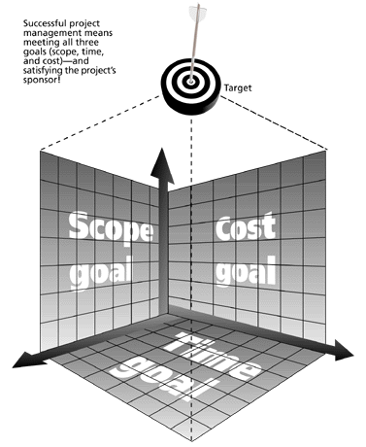
The Triple Constraint of Project Management
Successful project management means meeting all three goals (scope, time, and cost) – and satisfying the project’s sponsor!
Notes:
Managing the triple constraint involves making trade-offs between scope, time, and cost goals for a project. For example, you might need to increase the budget for a project to meet scope and time goals. Alternatively, you might have to reduce the scope of a project to meet time and cost goals. Experienced project managers know that you must decide which aspect of the triple constraint is most important. If time is most important, you must often change the initial scope and cost goals to meet the schedule. If scope goals are most important, you may need to adjust time and cost goals.

Slide 9
Project Constraints
Project scope is the detailed description of the project work necessary to meet the requirements of the stakeholders. It obviously addresses what is included. However, by addressing what is excluded can significantly improve the clarity of the required work.
Project costs are the total funds needed to monetarily cover and complete a business transaction or work project. Project costs involve: direct costs and indirect costs
  Direct costs are those directly involved with, and necessary in order to complete said project.
  Indirect cost (which are not directly included)
Project schedule indicates what needs to be done, which resources must be utilized, and when the project is due.
  In short, it's a timetable that outlines start and end dates and milestones that must be met for the project to be completed on time
In project management, customer satisfaction is part of project quality management and ensures that policies, objectives and responsibilities of the project satisfy all stakeholders involved.

Slide 10
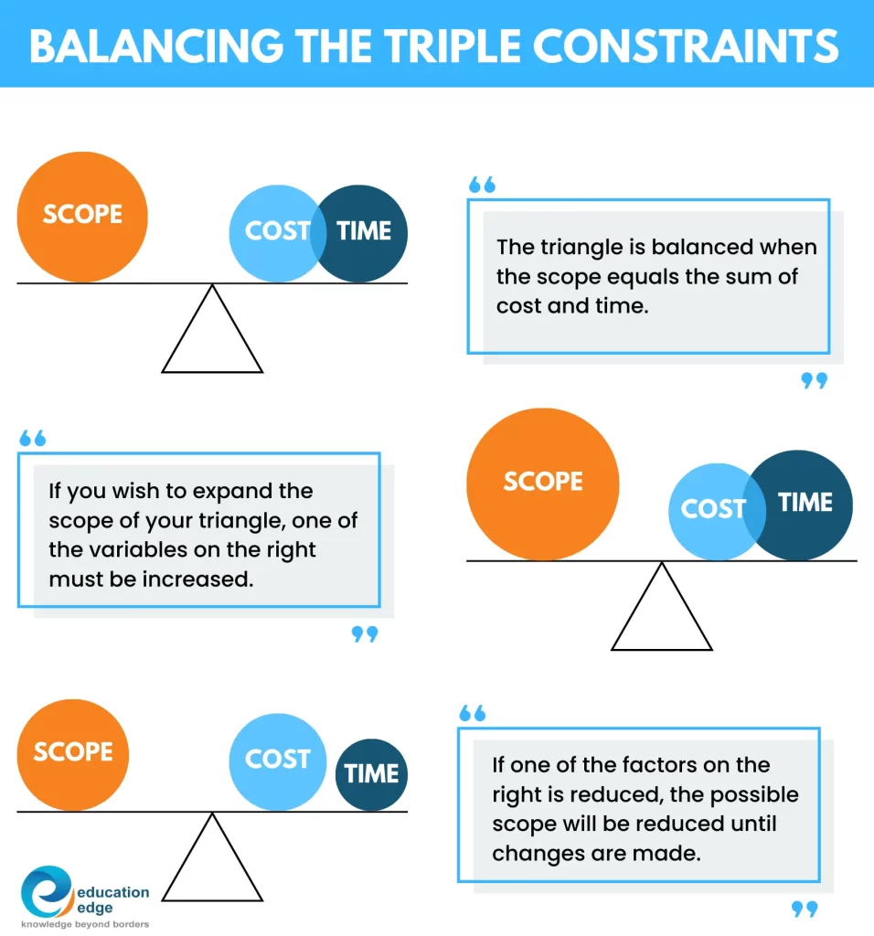
Notes:
https://www.educationedge.ca/blog/project-management-triangle

Slide 11
Project Constraints
Time Constraints
Time constraint may lead to less quality because of ?
    less time for analysis,
    less time for planning,
    less time for reviewing,
    less time for checking,
    less time for monitoring,
    less time for control,

Slide 12
Project Constraints
Cost Constraints
Cost constraint may lead to less quality because of ?
Hiring less skilled people
Getting less quality resources (HW, SW)
Ignoring some customer requirements

Slide 13
Project Constraints
Scope Constraints
Scope limitations may lead to lower quality because of?
Scope limitations may lead to ignoring some customer requirements
Shortcuts

Slide 14
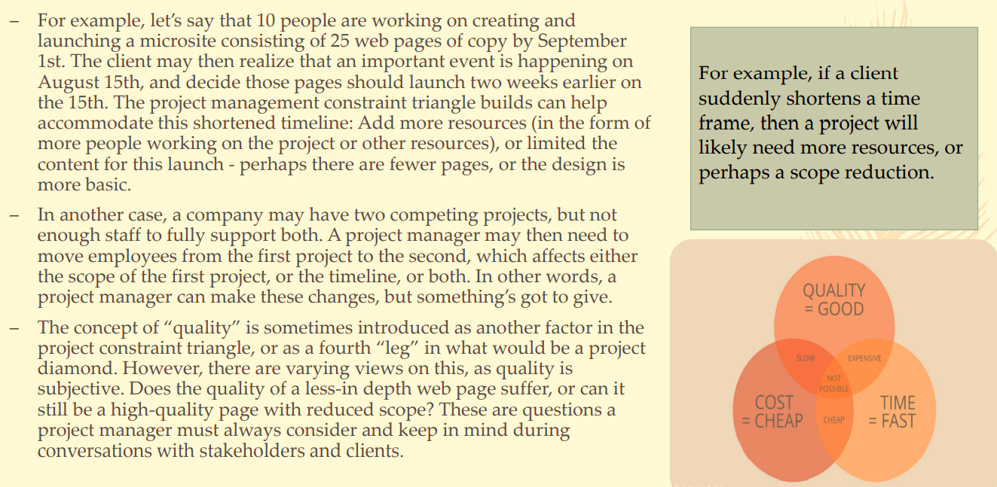
Project Constraints

Slide 15
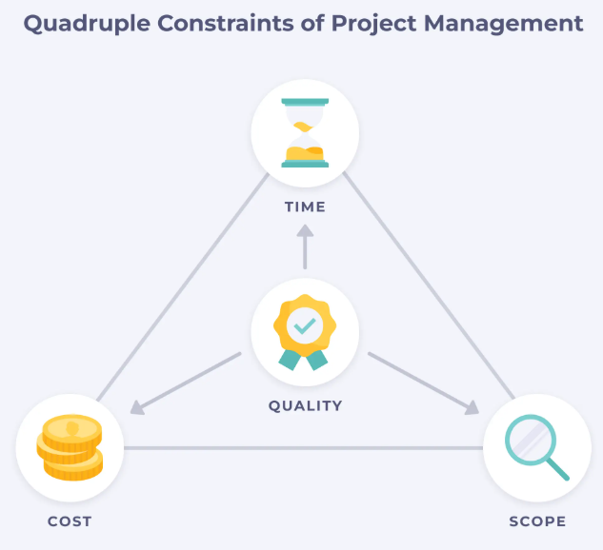
Quadruple Constraint
Quality is a key factor for projects success. We may add Quality as a 4th constraint:
The Quadruple constraint =
The Triple constraint +
Quality constraint
Cost

Slide 16
What is Project Management?
Project management is “the application of knowledge, skills, tools and techniques to project activities to meet project requirements”
(PMBOK® Guide, Third Edition, 2004, p. 8)
Project managers strive to meet the triple constraint by balancing project scope, time, and cost goals

Slide 17
Software Project Management
Software project management is a specialized discipline within the realm of project management that focuses on planning, executing, monitoring, controlling, and closing software development projects. It encompasses the systematic management of resources, budget and time to ensure the successful completion of a software project

Slide 18
Dimensions of a Software Project
A software project has two main activity dimensions:
  Software Engineering
    The engineering dimension deals with building the system and focuses on issues such as how to design, test, code, and so on.
  Project Management
      The project management dimension deals with properly planning and controlling the engineering activities to meet project goals for cost, schedule, and quality.
For small projects an email may be fine, but for large commercial projects you need:
    Defined Processes, a degree of formality
    Tested and Documented processes
    To Secure the Quality of outcome

Slide 19
Software Project Management
A method and a set of techniques based on the accepted principles of management used for planning, estimating and controlling work activities to reach a desired end result on time – within budget and according to software specifications.
“Robert K. Wysocki / Robert Beck Jr. / David B. Crane, Effective Project Management, 2. ed., John Wiley & Sons, 2002, ”
Project management is the planning, organizing, directing, and controlling of company resources for a relatively short-term objective that has been established to complete specific goals and objectives.“
“Harold Kerzner, Project Management: A Systems Approach to Planing, Scheduling and Controlling, John Wiley & Sons, Inc., New York et. al., 7. ed, 2001, p. 4”

Slide 20
Benefits of Project Management
Project management is a powerful business tool that can deliver many advantages to businesses of all sizes.
It gives you repeatable processes, guidelines and techniques to help you manage the people and the work involved in your projects.
It can increase your chances of success and help you deliver projects consistently, efficiently, on time and budget.
Not having a process to manage your projects can result in lost time, wasted money, inconsistencies and poor performance.

Slide 21
The main advantage of project management is that is helps you to manage your projects effectively, enabling you to resolve problems more quickly.
It takes time and money to manage a project, however following good practices can help you
improve productivity and quality of work
encourage consistent communications amongst staff, suppliers and clients
satisfy the various needs of the project's stakeholders
mitigate risks of a project failing
increase customer satisfaction
gain a competitive advantage and boost your bottom line
improve your chances of achieving the desired result
gain a fresh perspective on your project, and how it fits with your business strategy
prioritize your business' resources and ensure their efficient use
set the scope, schedule and budget accurately from the start
stay on schedule and keep costs and resources to budget

Slide 22
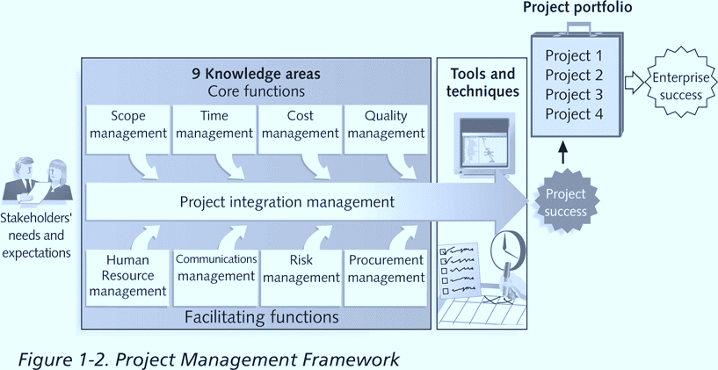
Project Management Framework

Slide 23
Project Stakeholders
Stakeholders are the people involved in or affected by project activities
Stakeholders include:
  The project sponsor
  The project manager
  The project team
  Support staff
  Customers
  Users
  Suppliers
  Opponents to the project

Slide 24
Nine Project Management Knowledge Areas
Knowledge areas describe the key competencies that project managers must develop
  Four core knowledge areas lead to specific project objectives (scope, time, cost, and quality)
  Four facilitating knowledge areas are the means through which the project objectives are achieved (human resources, communication, risk, and procurement management
  One knowledge area (project integration management) affects and is affected by all of the other knowledge areas
  All knowledge areas are important!

Slide 25
Project Management Tools and Techniques
Project management tools and techniques assist project managers and their teams in various aspects of project management
Some specific ones include:
  Project charter, scope statement, and WBS (scope)
  Gantt charts, network diagrams, critical path analysis, and critical chain scheduling (time)
  Cost estimates and earned value management (cost)

Slide 26
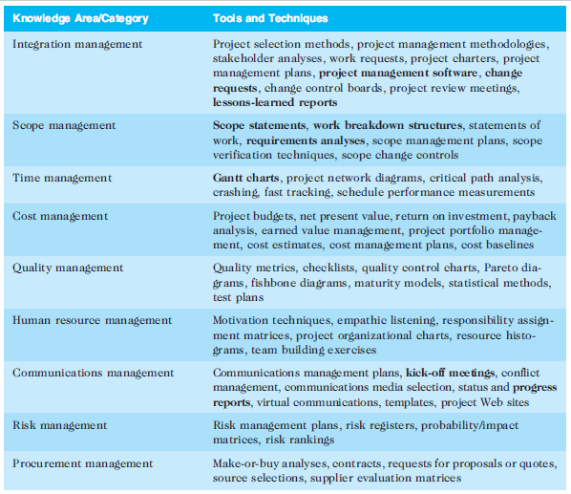

Slide 27
Super Tools
“Super tools” are those tools that have high use and high potential for improving project success, such as:
  Software for task scheduling (such as project management software)
  Scope statements
  Requirements analyses
  Lessons-learned reports
Tools already extensively used that have been found to improve project importance include:
  Progress reports
  Kick-off meetings
  Gantt charts
  Change requests
Notes:
A kickoff meeting is the first official team meeting at the start of a project. During the meeting, important team members and leaders finalize a plan for project completion.

Slide 28
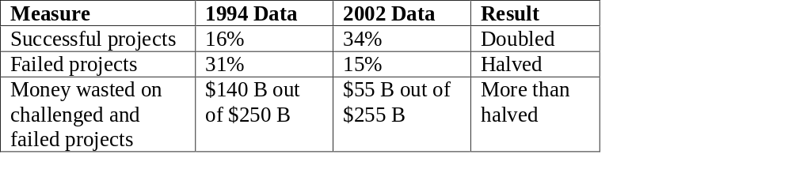
What Went Right? Improved Project Performance
The Standish Group’s CHAOS studies show improvements in IT projects in the past decade

Slide 29
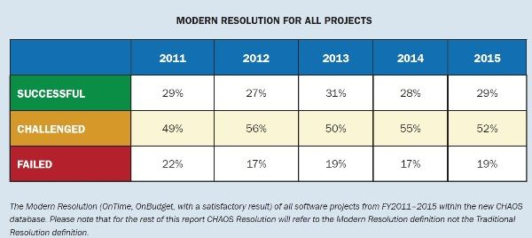
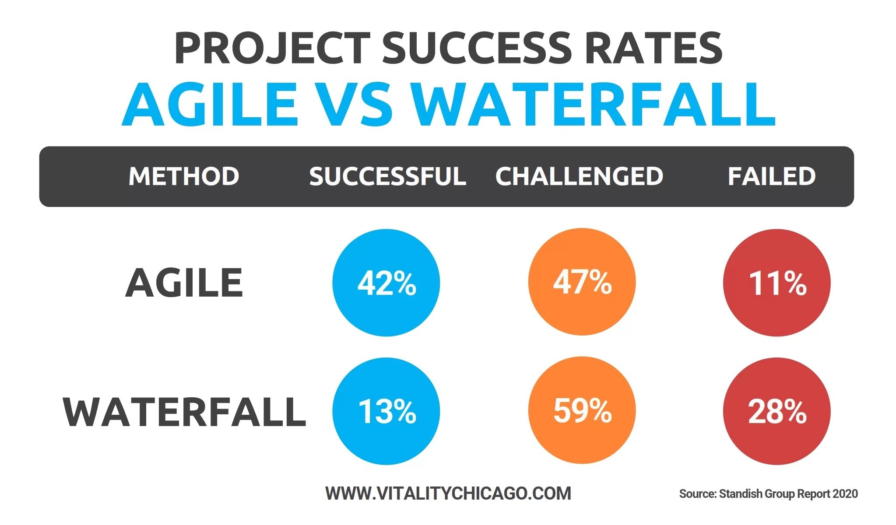

Slide 30
Chaos Report 2020
35% successful
45% exceeded deadline and budget
20% canceled

Slide 31
Chaos Report 2024
31% successful
50% exceeded deadline and budget
19% canceled
Top Success & Failure Drivers
Success Drivers: Strong executive sponsorship, clear requirements, and skilled project teams.
Failure Drivers: Lack of user involvement (cited as a top reason for "impaired" projects), unrealistic timelines, and technical incompetence.

Slide 32
Why the Improvements?
"The reasons for the increase in successful projects vary. First, the average cost of a project has been more than cut in half. Better tools have been created to monitor and control progress and better skilled project managers with better management processes are being used. The fact that there are processes is significant in itself.”*

Slide 33
Project Success
There are several ways to define project success
  The project met scope, time, and cost goals
  The project satisfied the customer/sponsor
  The results of the project met its main objective, such as making or saving a certain amount of money, providing a good return on investment, or simply making the sponsors happy

Slide 34
What Helps Projects Succeed?*
Executive support
User involvement
Experienced project manager
Clear business objectives
Minimized scope
Standard software infrastructure
Firm basic requirements
Formal methodology
Reliable estimates
Other criteria, such as small milestones, proper planning, competent staff, and ownership

Slide 35
Causes of failure
Quantitative (Technical)
Qualitative (Socio-Cultural)
Ineffective planning
Ineffective scheduling
Ineffective estimating
Ineffective cost control
Project objectives not properly established
Poor morale
Poor motivation
Poor human relations
Poor productivity
No employee commitment
No functional commitment
Delays in problem solving
Too many unresolved policy issues
Conflicting priorities between executives, line managers, and project manager

Slide 36
Program
Program: group of related projects managed in a coordinated way to obtain benefits and control not available from managing them individually
(PMBOK® Guide, Third Edition, 2004, p. 16)

Slide 37
Project Managers Vs Program Managers
Project managers work with project sponsors, a project team, and other people involved in a project to meet project goals
Program managers oversee programs and often act as bosses for project managers
A program manager provides leadership and direction for the project managers heading the projects within the program

Slide 38
Project Portfolio Management
Project portfolio management is a strategy in which organizations, group and manage projects and programs as a portfolio of investments that contribute to the entire enterprise’s success.
Portfolio managers help their organizations make wise investment decisions by helping to select and analyze projects from a strategic perspective.
It is most important that they have strong financial and analytical skills and understand how projects and programs can contribute to meeting strategic goals.

Slide 39
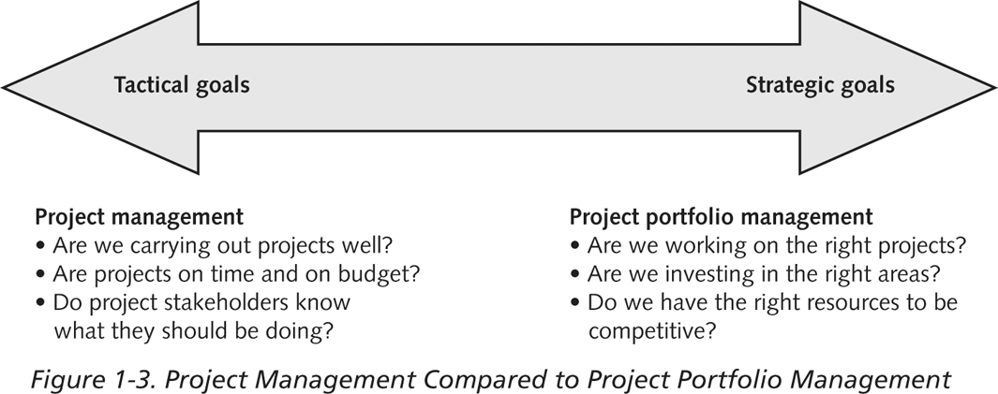
Differences Between Project Management And Project Portfolio Management

Slide 40
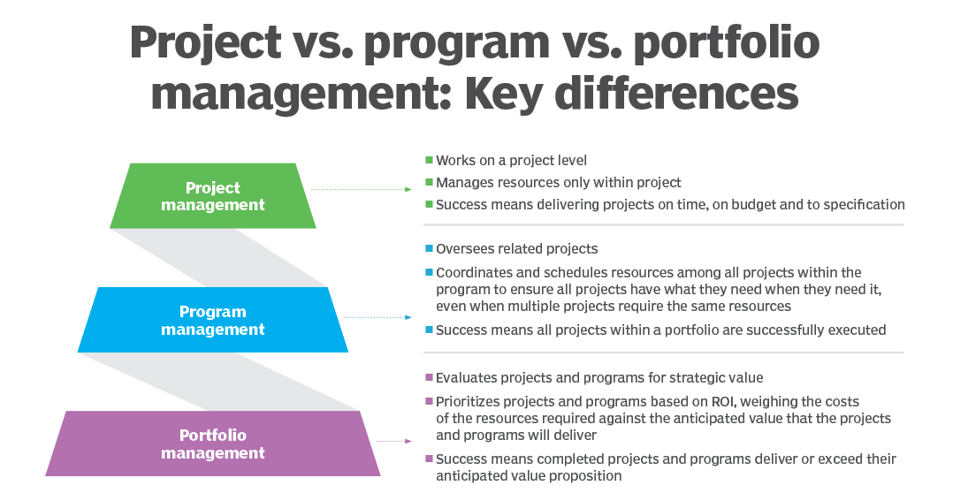
Project portfolio management vs. program management vs. project management
Notes:
https://www.techtarget.com/searchcio/definition/PPM-project-and-portfolio-management

Slide 41
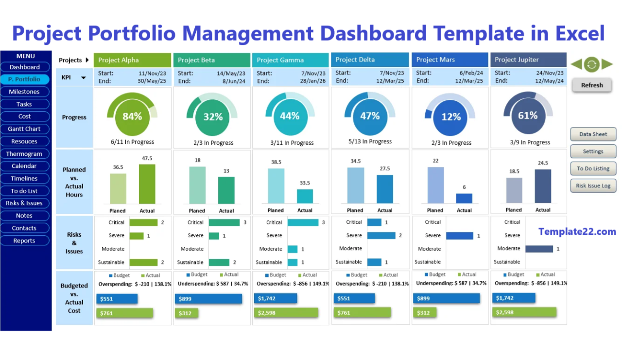
Sample Project Portfolio Approach
Notes:
https://template22.com/
The Most Advanced Project Planning Tool In The Industry
Template22 Project Plan Templates, trusted for over 7 years, is the #1 Excel solution for project and portfolio management. Loved for its powerful features, limitless designs, and excellent support, it delivers an unmatched planning experience. Discover why Template22 sets the standard for project planning.

Slide 42
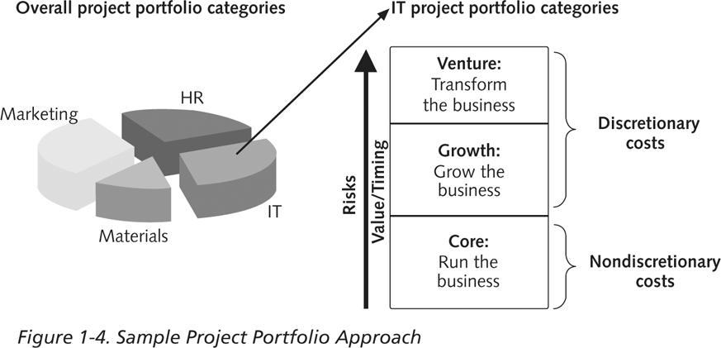
Sample Project Portfolio Approach

Slide 43
Best Practice
A best practice is “an optimal way recognized by industry to achieve a stated goal or objective”*
Robert Butrick suggests that organizations need to follow basic principles of project management, including these two mentioned below
  Make sure your projects are driven by your strategy; be able to demonstrate how each project you undertake fits your business strategy, and screen out unwanted projects as soon as possible
  Engage your stakeholders; ignoring stakeholders often leads to project failure
    Be sure to engage stakeholders at all stages of a project, and encourage teamwork and commitment at all times
*Project Management Institute, Inc., Organizational Project Management Maturity Model
(OPM3) Knowledge Foundation (2003), p. 13.

Slide 44
Roles and responsibilities of Project Manager
Planning the activities
Organizing a project team to perform work
Delegating the teams
Time management
Managing Deliveries
Monitor Progress
Establish Regular Meetings
Communicate a vision with the team
Managing reports and necessary documentation
Notes:
https://www.proofhub.com/articles/project-manager-roles-responsibilities

Slide 45
Required Knowledge for Project Managers
Knowledge of the Project Management Body
Application area knowledge, standards, and regulations
Project environment knowledge
General management knowledge and skills
Soft skills or human relations skills

Slide 46
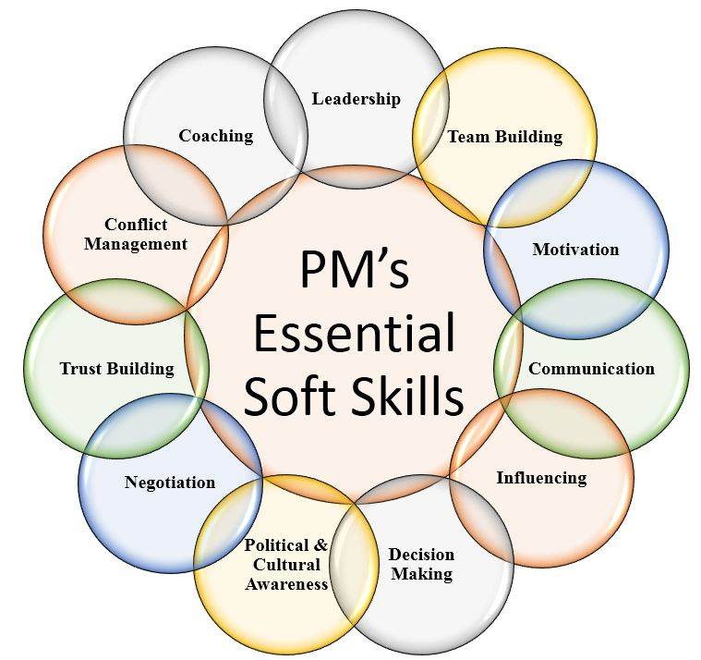
Project Manager’s Skills
Leadership and team Building
Communications
Problem Solving
Negotiation and influencing skills
Influencing the Organization
Mentoring
Process and technical expertise (Application skills)
Organizational and planning skills
Conflict management

Slide 47
Skills and Competencies for Project Managers
Be comfortable with change
Understand the organizations they work in and with
Leadership
Listening
Integrity, ethical behavior, consistent
Strong at building trust
Verbal communication
Strong at building teams
Conflict resolution, conflict management
Critical thinking, problem solving
Understands, balances priorities

Slide 48
Different Skills Needed in Different Situations
Large projects: leadership, relevant prior experience, planning, people skills, verbal communication, and team-building skills are most important
High uncertainty projects: risk management, expectation management, leadership, people skills, and planning skills are most important
Very novel projects: leadership, people skills, having vision and goals, self-confidence, expectations management, and listening skills are most important

Slide 49
Importance of Leadership Skills
Effective project managers provide leadership by example
A leader focuses on long-term goals and big-picture objectives while inspiring people to reach those goals
A manager deals with the day-to-day details of meeting specific goals
Project managers often take on the role of both leader and manager

Slide 50
Careers for IT Project Managers
The demand for IT project managers and project management skills is on the rise. According to the U.S. Bureau of Labor Statistics, new jobs for computer and information systems managers will grow by 11% from 2020 to 2030

Slide 51
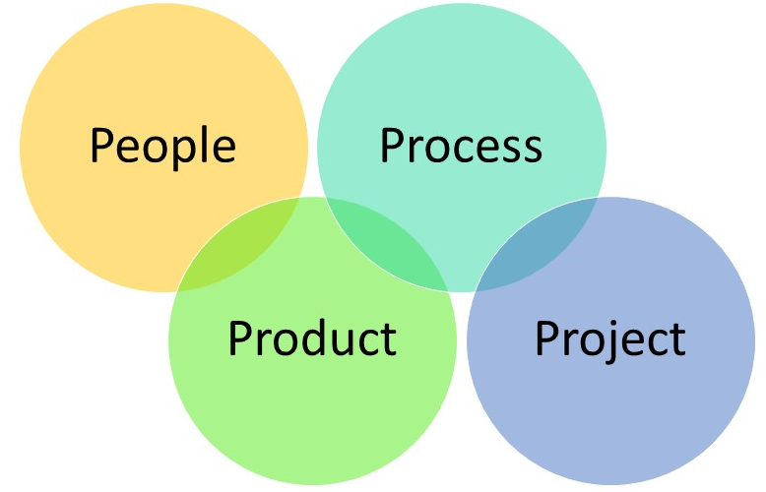
4 P’s in SPM
People
Product
Process
Project

Slide 52
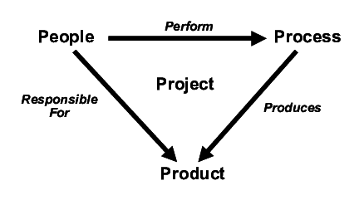
4 P’s in SPM

Slide 53

W5HH Principle of SPM
44
Why is the system being develop?
  Answer to this questions help assess validity of business reason for the software work.
  It answers if the business purpose justifies the expenditure of people, time and money
What will be done?
  Answer to this question establishes the task set required for project
When will it be done?
  Answer to this question helps the team establish a project schedule by identifying when tasks have to be conducted and when milestones are to be reached

Slide 54

W5HH Principle of SPM
45
Who is responsible for a function ?
  Answer to this question establishes roles and responsibility of each team member
Where are they organizationally located ?
  Answer to this question indicates that all roles and responsibilities are not limited to the software team itself, the customers, users and stakeholders also have responsibilities.
How will be job done technically and managerially ?
  Once product scope is establishes, a technical and management strategy must be defined for it.
How much of each resource is needed ?
  Answer to this question is derived by developing estimates based on answers to earlier questions.

Slide 55
Chapter Summary
A project is a temporary endeavor undertaken to create a unique product, service, or result
Project management is the application of knowledge, skills, tools, and techniques to project activities to meet project requirements
A program is a group of related projects managed in a coordinated way; project portfolio management involves organizing and managing projects and programs as a portfolio of investments
Project managers play a key role in helping projects and organizations succeed
The project management profession continues to grow and mature

